Slide 1

SDG accelerator analyses: What we know how to do and what we should look out for
The Accelerate Hub WP2 Meeting
Oct 31st, 2019, Oxford UK
Will Rudgard and Mark Orkin
william.rudgard@spi.ox.ac.uk
mark.orkin@gmail.com

Slide 2

What is an SDG?
WP2 SDG mapping slides from October 31, 2019
Updated in November 2019
https://www.dropbox.com/s/4dn5d15nftoiukt/Mapping%20SDG%20targets%20and%20indicators%20for%20accelerator%20analyses_31Oct2019.pptx?dl=0
Notes:
17 goals broken into targets (e.g SDG 1 has 5 targets) broken into indicators

Slide 3

What is a Development Accelerator?
Actions (e.g interventions: cash transfers, parenting support) that will take us forward more quickly across a broad range of interlinked goals
Notes:
Actions e.g interventions: Cash, food, education

Slide 4
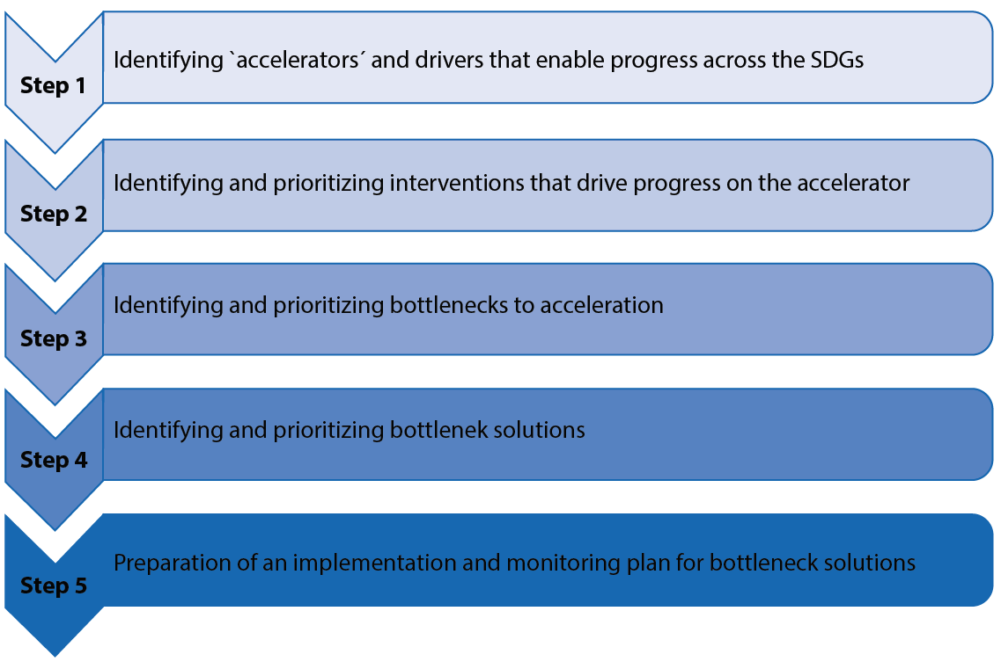


Accelerator and Bottleneck Assessment Tool
Notes:
Step 3 think about moderation (negative aspect)

Slide 5
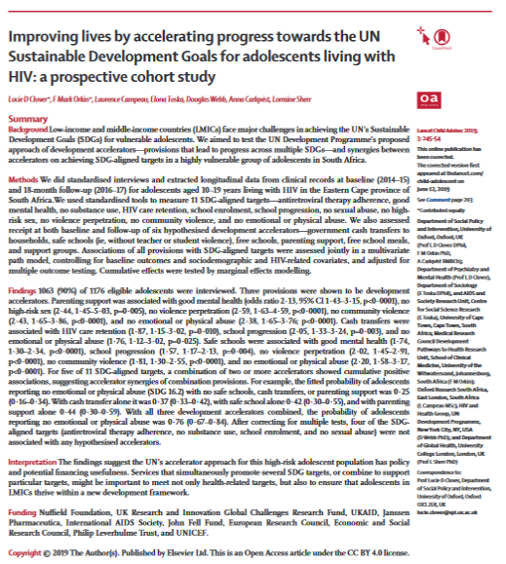
Mzantsi Wakho Case Study
Prospective cohort study
2 time points
6 hypothesized accelerators
Cash transfers
Safe school
Free school
Parenting support
Free school meals
School support
11 adolescent outcomes linked to targets across 4 SDGs
Notes:
Receipt of accelerators was measured as access at both baseline and follow-up.

Slide 6
How to choose accelerators?
Accelerators may be:
Interventions: cash transfer, schooling (no fees, meals)
Practices for which interventions could be implemented: positive parenting, safe school
Accelerators shouldn’t be too vague:
Reduce food insecurity (too broad) vs
Food support/ Access to school meals (better)
A study may investigate one, or multiple (even six!) potential accelerators

Slide 7
Methodological approach
What is definite for accelerators?
Multiple outcomes
What is definite for synergies across accelerators?
Multiple accelerators - observational
More than two arms - randomised control trial
What is desirable?
More than one time point
All of the general criteria for a rigorous study design

Slide 8
What do we need to look out for?
Starting afresh on a new dataset?
Think about data cleaning:
Missing values
Outliers
Miscodings
Think about study design:
Temporal precedence
Think about how outcomes should be coded
Linear
Continuous

Slide 9
Practical ways into the analysis
Map out potential accelerator variables and SDG-related outcome variables in the dataset
LOGICAL checks ☺ Check theory and evidence on accelerators (i) in LMIC/ SSA? (ii) for adolescents (iii) ANY evidence?
DATA check ☺ Inspect potential “accelerators” and SDG outcomes for correlation
Exploratory analysis: 2x2 tables or correlation matrix
Run single outcome regressions with accelerators and controls (eyeballing for collinearity)
Run multiple outcome regression with accelerators and controls
Notes:
Is it valid to test association between x and y
– keep and eye on Standard Errors

Slide 10
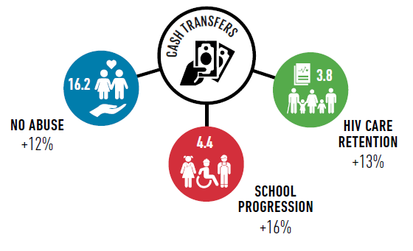
Testing for accelerators - Part 1
Accelerator
Outcome
Outcome
Outcome

Slide 11


Testing for accelerators - Part 2

Slide 12

Testing for synergies between accelerators

Slide 13
Illustration of cash transfer accelerator
Cash transfers are significantly associated with 1) HIV care retention; 2) School progression; 3) No emotional abuse.
Notes:
Remind audience that receipt of accelerators was continuous across T1 and T2.

Slide 14
Illustration of synergy across accelerators
Safe schooling, cash transfers, and parenting support are all significantly associated with emotional abuse.

Slide 15

How to choose SDG outcomes?
Outcomes should be:
Operationalisable (i.e. validly measurable)
Modifiable (something that can be improved)
Salient in countries’ national development agendas
Emerging priorities
Responsive to the needs of the traditionally marginalized
Source: UNDP (2018). SDG Accelerator and Bottleneck Assessment

Slide 16
MANCOVA & Path Analysis
One potential accelerator and multiple outcomes – MANCOVA
STATA: https://stats.idre.ucla.edu/stata/dae/multivariate-regression-analysis/
R: http://www.rpubs.com/tbihansk/302732
Multiple potential accelerators and multiple outcomes – Path analysis
STATA: https://stats.idre.ucla.edu/mplus/seminars/intromplus-part2/analyzing-data-path-analysis/
R: http://www.rpubs.com/tbihansk/302732
Multiple outcome correction – Benjamini & Hochberg
Excel: https://www.statisticshowto.datasciencecentral.com/benjamini-hochberg-procedure/

Slide 17
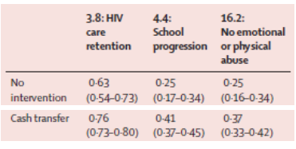
Predictive margins and marginal effects
Adjusted predicted probabilities
Marginal effects: the effect on the predicted probability of y of a change in one of the explanatory factors.
Receipt vs. no receipt of our accelerator.
Marginal effects can estimate the incremental gain from:
One accelerator
Combinations of accelerators

Slide 18
Thank you!
william.rudgard@spi.ox.ac.uk
mark.orkin@gmail.com

